Slide 1
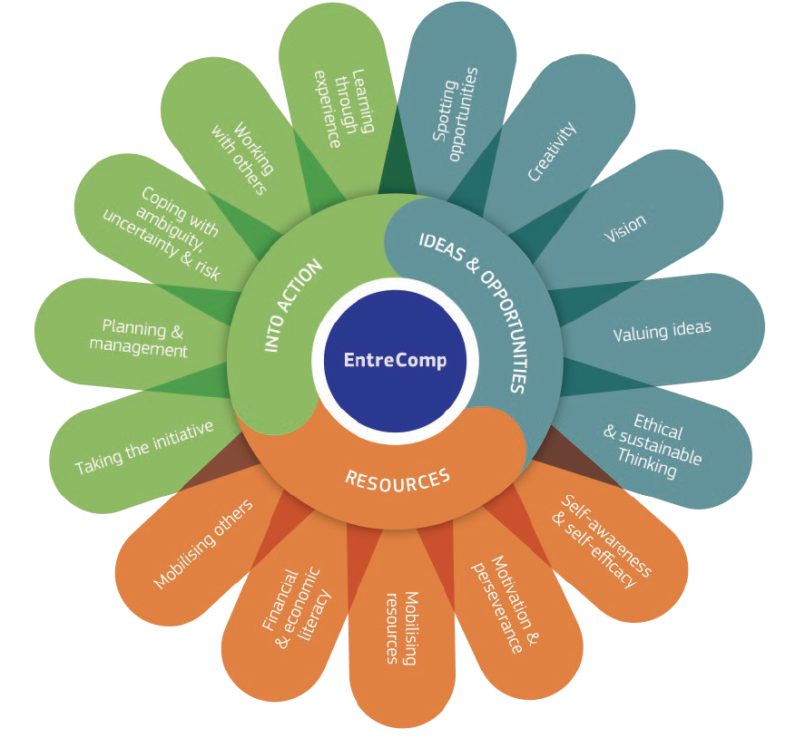
1.5 Ethical and sustainable thinking
1.5.A Behave ethically
This project has been funded with support from the European Commission. This document and its contents reflect the views only of the authors, and the Commission cannot be held responsible for any use which may be made of the information contained therein​
Legal description – Creative Commons licensing: The materials published on the EntreComp project website are classified as Open Educational Resources' (OER) and can be freely (without permission of their creators): downloaded, used, reused, copied, adapted, and shared by users, with information about the source of their origin.

Slide 2
Introduction
To be able to think ethical and sustainable means to assess the consequences and impact of ideas, opportunities and actions.
Ethical and sustainable thinking is a matter of the attitudes, behaviors, values and mindset that an entrepreneur should have to take ethical decisions as well as act and think sustainably.
Typically, an ethically and sustainably thinking entrepreneur does not just have profit but also the people and planet in mind.
This project has been funded with support from the European Commission. This document and its contents reflect the views only of the authors, and the Commission cannot be held responsible for any use which may be made of the information contained therein​
Legal description – Creative Commons licensing: The materials published on the EntreComp project website are classified as Open Educational Resources' (OER) and can be freely (without permission of their creators): downloaded, used, reused, copied, adapted, and shared by users, with information about the source of their origin.

Slide 3
Definition of ethics
Ethics are the basic, moral ground rules by which we live our lives and make decisions.
Ethical behaviours show:
Responsibility
Honesty
Courage
Integrity
Commitment
This project has been funded with support from the European Commission. This document and its contents reflect the views only of the authors, and the Commission cannot be held responsible for any use which may be made of the information contained therein​
Legal description – Creative Commons licensing: The materials published on the EntreComp project website are classified as Open Educational Resources' (OER) and can be freely (without permission of their creators): downloaded, used, reused, copied, adapted, and shared by users, with information about the source of their origin.

Slide 4
Ethical Decision Making
planet
profit
Ethical decisions are affected by …
society
Ethical decision-making is to assess the consequences and impact of ideas and actions that bring values as well as the effect of entrepreneurial action on the target community, the market, society and the environment.
This project has been funded with support from the European Commission. This document and its contents reflect the views only of the authors, and the Commission cannot be held responsible for any use which may be made of the information contained therein​
Legal description – Creative Commons licensing: The materials published on the EntreComp project website are classified as Open Educational Resources' (OER) and can be freely (without permission of their creators): downloaded, used, reused, copied, adapted, and shared by users, with information about the source of their origin.

Slide 5
Ethical decisions: why they matter?
The digitalisation and the growth of companies becomes faster and faster
This trend comes with ethical challenges for society as the companies bring their innovation/ products/ ideas to different parties without considering the full implications of their business
Entrepreneurs are mostly unaware of the ethical consequences of their decisions
This project has been funded with support from the European Commission. This document and its contents reflect the views only of the authors, and the Commission cannot be held responsible for any use which may be made of the information contained therein​
Legal description – Creative Commons licensing: The materials published on the EntreComp project website are classified as Open Educational Resources' (OER) and can be freely (without permission of their creators): downloaded, used, reused, copied, adapted, and shared by users, with information about the source of their origin.

Slide 6
Ethical decisions: why they matter?
In most cases the entrepreneur use an unstructured approach to solve ethical dilemmas, with instincts or “common sense” as main drivers for decision making
The entrepreneurs focused on company survival, with little consideration of other parties
Ethical decision lead to engagement of all stakeholders in a business and
their need to be heard and taken into account by companies
Source: Velasquez, M., Andre C., Shanks, T., S.J., Meyer M. (2015). Thinking Ethically, Santa Clara: publicised through Markkula Center for Applied Science at Santa Clara University, via https://www.scu.edu/ethics/ethics-resources/ethical-decision-making/thinking-ethically/, access: 28.10.2020
This project has been funded with support from the European Commission. This document and its contents reflect the views only of the authors, and the Commission cannot be held responsible for any use which may be made of the information contained therein​
Legal description – Creative Commons licensing: The materials published on the EntreComp project website are classified as Open Educational Resources' (OER) and can be freely (without permission of their creators): downloaded, used, reused, copied, adapted, and shared by users, with information about the source of their origin.

Slide 7
Norms and values
Norms and values should guide the ethical decision making. The decision maker should always consider his/her impact on all parties involved and influenced by the decision.
Utilitarian Approach
Common-Good Approach
Moral-Rights Approach
Justice Approach
Virtue Approach
Source: Velasquez, M., Andre C., Shanks, T., S.J., Meyer M. (2015). Thinking Ethically, Santa Clara: publicised through Markkula Center for Applied Science at Santa Clara University, via https://www.scu.edu/ethics/ethics-resources/ethical-decision-making/thinking-ethically/, access: 28.10.2020
This project has been funded with support from the European Commission. This document and its contents reflect the views only of the authors, and the Commission cannot be held responsible for any use which may be made of the information contained therein​
Legal description – Creative Commons licensing: The materials published on the EntreComp project website are classified as Open Educational Resources' (OER) and can be freely (without permission of their creators): downloaded, used, reused, copied, adapted, and shared by users, with information about the source of their origin.

Slide 8
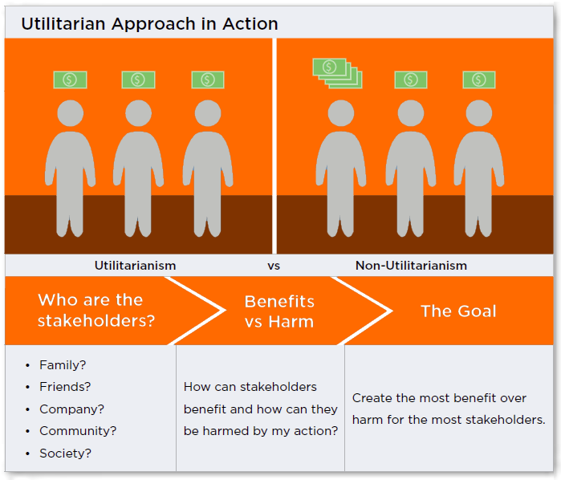
An Utilitarian Approach
The ethical choice is the one that produces the greatest good for the greatest number.
Source: Velasquez, M., Andre C., Shanks, T., S.J., Meyer M. (2015). Thinking Ethically, Santa Clara: publicised through Markkula Center for Applied Science at Santa Clara University, via https://www.scu.edu/ethics/ethics-resources/ethical-decision-making/thinking-ethically/, access: 28.10.2020
This project has been funded with support from the European Commission. This document and its contents reflect the views only of the authors, and the Commission cannot be held responsible for any use which may be made of the information contained therein​
Legal description – Creative Commons licensing: The materials published on the EntreComp project website are classified as Open Educational Resources' (OER) and can be freely (without permission of their creators): downloaded, used, reused, copied, adapted, and shared by users, with information about the source of their origin.

Slide 9
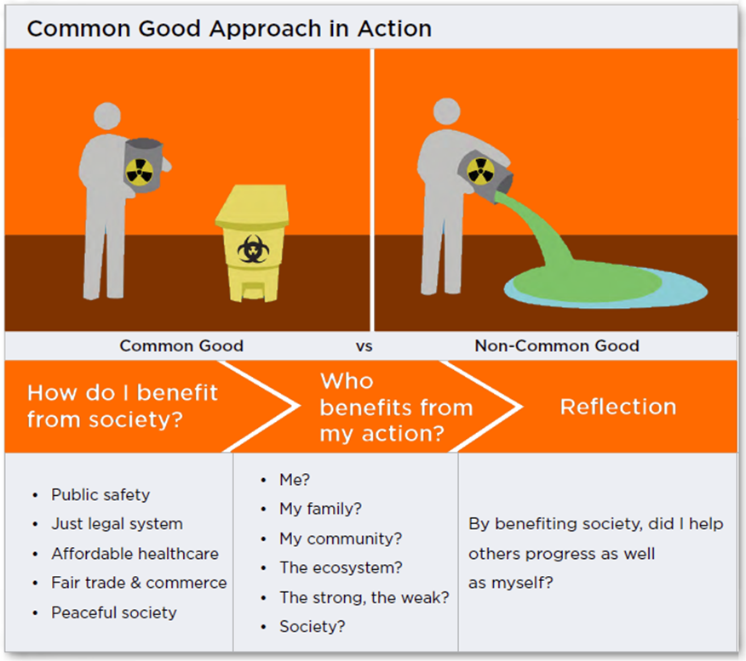
A Common-Good Approach
This ethical approach is based on a society consisting of individuals whose own well-being is inseparably linked to the well-being of the community
The members of the community are bound by the pursuit of common values and goals
Source: Velasquez, M., Andre C., Shanks, T., S.J., Meyer M. (2015). Thinking Ethically, Santa Clara: publicised through Markkula Center for Applied Science at Santa Clara University, via https://www.scu.edu/ethics/ethics-resources/ethical-decision-making/thinking-ethically/, access: 28.10.2020
This project has been funded with support from the European Commission. This document and its contents reflect the views only of the authors, and the Commission cannot be held responsible for any use which may be made of the information contained therein​
Legal description – Creative Commons licensing: The materials published on the EntreComp project website are classified as Open Educational Resources' (OER) and can be freely (without permission of their creators): downloaded, used, reused, copied, adapted, and shared by users, with information about the source of their origin.

Slide 10
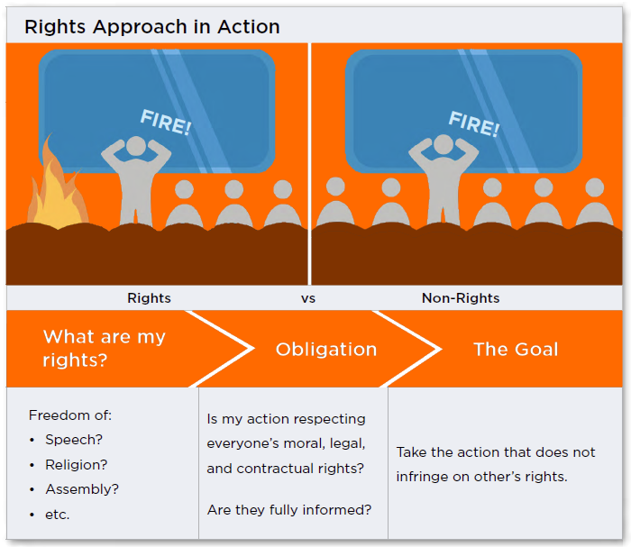
A Moral-Rights Approach
Ethical decisions are those that best maintain the fundamental rights of the people affected by them.
Source: Velasquez, M., Andre C., Shanks, T., S.J., Meyer M. (2015). Thinking Ethically, Santa Clara: publicised through Markkula Center for Applied Science at Santa Clara University, via https://www.scu.edu/ethics/ethics-resources/ethical-decision-making/thinking-ethically/, access: 28.10.2020
This project has been funded with support from the European Commission. This document and its contents reflect the views only of the authors, and the Commission cannot be held responsible for any use which may be made of the information contained therein​
Legal description – Creative Commons licensing: The materials published on the EntreComp project website are classified as Open Educational Resources' (OER) and can be freely (without permission of their creators): downloaded, used, reused, copied, adapted, and shared by users, with information about the source of their origin.

Slide 11
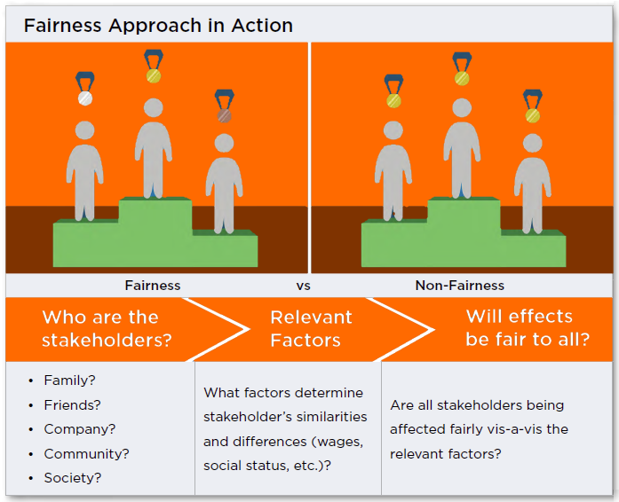
A Justice/Fairness Approach
Ethical decisions must be based on standards of equity, fairness and impartiality. Three types of justice:
Distributive: treatment for proper reasons
Procedural: rules clearly stated and applied
Compensatory: compensated fairly
Source: Velasquez, M., Andre C., Shanks, T., S.J., Meyer M. (2015). Thinking Ethically, Santa Clara: publicised through Markkula Center for Applied Science at Santa Clara University, via https://www.scu.edu/ethics/ethics-resources/ethical-decision-making/thinking-ethically/, access: 28.10.2020
This project has been funded with support from the European Commission. This document and its contents reflect the views only of the authors, and the Commission cannot be held responsible for any use which may be made of the information contained therein​
Legal description – Creative Commons licensing: The materials published on the EntreComp project website are classified as Open Educational Resources' (OER) and can be freely (without permission of their creators): downloaded, used, reused, copied, adapted, and shared by users, with information about the source of their origin.

Slide 12
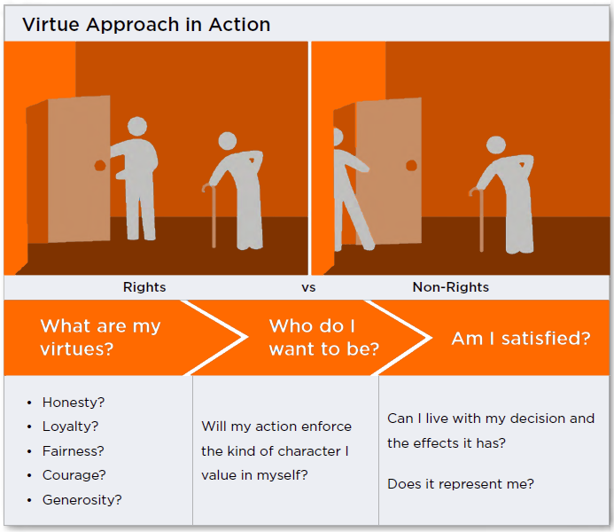
A Virtue Approach
The virtue approach assumes that there are certain ideals/virtues (e.g. honesty, courage, compassion, generosity, fidelity, integrity, fairness, self-control, and prudence) toward which we should strive, which provide for the full development of our humanity
The virtuous person is the ethical person
Source: Velasquez, M., Andre C., Shanks, T., S.J., Meyer M. (2015). Thinking Ethically, Santa Clara: publicised through Markkula Center for Applied Science at Santa Clara University, via https://www.scu.edu/ethics/ethics-resources/ethical-decision-making/thinking-ethically/, access: 28.10.2020
This project has been funded with support from the European Commission. This document and its contents reflect the views only of the authors, and the Commission cannot be held responsible for any use which may be made of the information contained therein​
Legal description – Creative Commons licensing: The materials published on the EntreComp project website are classified as Open Educational Resources' (OER) and can be freely (without permission of their creators): downloaded, used, reused, copied, adapted, and shared by users, with information about the source of their origin.

Slide 13
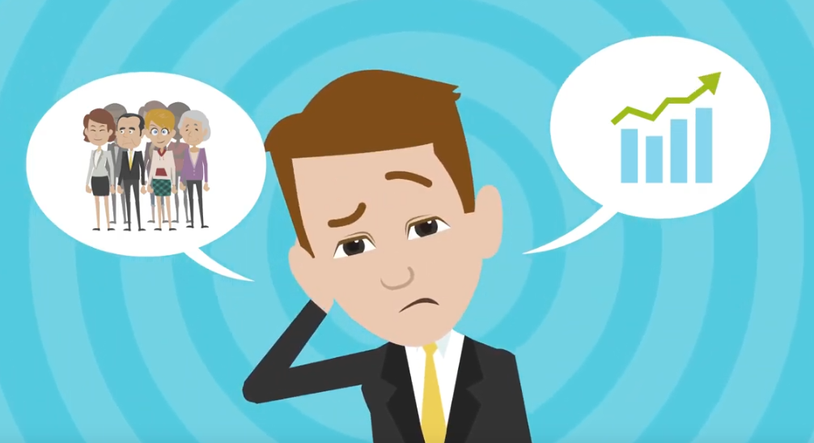
The Dilemma scenarios
Students can learn to think and act ethically and sustainably through dilemma scenarios by discussing about which decision they would choose.
Dilemma scenarios help learners take into account all different parties affected by a decision: they work well in this context as they link real-life experiences of learners and ignite discussion.
Watch this video
Source: Global Ethics Inc. (2019). Business Ethical Dilemmas and Stakeholders [video], via https://www.youtube.com/watch?v=ahH_P_5yVSo, access: 28.10.2020
This project has been funded with support from the European Commission. This document and its contents reflect the views only of the authors, and the Commission cannot be held responsible for any use which may be made of the information contained therein​
Legal description – Creative Commons licensing: The materials published on the EntreComp project website are classified as Open Educational Resources' (OER) and can be freely (without permission of their creators): downloaded, used, reused, copied, adapted, and shared by users, with information about the source of their origin.

Slide 14
Exercise: Dilemma Scenarios
Please read the following three ethical dilemma scenarios and go on to next slide:
The Tax
Loophole
In this scenario you or your accountant has found a legal tax loophole, which allows you to save a considerable amount of money, however you are aware that this is simply an oversight from the tax office, and if all businesses were to indulge in this, there would be considerable problems for the government. How do you make your decision?
Investor
Scandal
In this scenario one of your main investors is involved in an ethical scandal. You are aware that without his/her investment, your company will suffer greatly, however, the scandal he is involved in goes against everything you stand for (a repulsive situation). How do you make your decision?
Employees and Financial Problems
In this scenario you are faced with financial difficulties which threaten to bankrupt your business, however the outcome is uncertain. You are aware that if you communicate these problems to your employees you may risk losing them, however you are also aware of your obligation towards their wellbeing, and that by not communicating this problem you may jeopardize their financial situation. How do you make your decision?
This project has been funded with support from the European Commission. This document and its contents reflect the views only of the authors, and the Commission cannot be held responsible for any use which may be made of the information contained therein​
Legal description – Creative Commons licensing: The materials published on the EntreComp project website are classified as Open Educational Resources' (OER) and can be freely (without permission of their creators): downloaded, used, reused, copied, adapted, and shared by users, with information about the source of their origin.

Slide 15
Following…
Most ethical Dilemmas involve a conflict between the needs of a part and the whole, between the company interests and the society as a whole.
TASK 1: Discuss one of the ethical dilemmas last page. How would you decide? Ask yourselves the five questions when trying to resolve a moral issue:
What benefits and what harms will each course of action produce, and which alternative will lead to the best overall consequences?
What moral rights do the affected parties have, and which course of action best respects those rights?
Which course of action treats everyone the same, except where there is a morally justifiable reason not to, and does not show favoritism or discrimination?
Which course of action advances the common good?
Which course of action develops moral virtues?
This project has been funded with support from the European Commission. This document and its contents reflect the views only of the authors, and the Commission cannot be held responsible for any use which may be made of the information contained therein​
Legal description – Creative Commons licensing: The materials published on the EntreComp project website are classified as Open Educational Resources' (OER) and can be freely (without permission of their creators): downloaded, used, reused, copied, adapted, and shared by users, with information about the source of their origin.

Slide 16
Following…
TASK 2: Check your decision with the following interview scheme:
Ethical dilemma interview
Has this ever happened?
Is the decision taken in isolation?
Do you use any non-human guidance?
How would you evaluate them?
Is this a common
way to handle?
Is this something common?
Are there any indirect repercussions of your decisions?
Is there any formal company culture guidance?
This project has been funded with support from the European Commission. This document and its contents reflect the views only of the authors, and the Commission cannot be held responsible for any use which may be made of the information contained therein​
Legal description – Creative Commons licensing: The materials published on the EntreComp project website are classified as Open Educational Resources' (OER) and can be freely (without permission of their creators): downloaded, used, reused, copied, adapted, and shared by users, with information about the source of their origin.

Slide 17
1.5 Ethical and sustainable thinking
1.5.B Think sustainably
This project has been funded with support from the European Commission. This document and its contents reflect the views only of the authors, and the Commission cannot be held responsible for any use which may be made of the information contained therein​
Legal description – Creative Commons licensing: The materials published on the EntreComp project website are classified as Open Educational Resources' (OER) and can be freely (without permission of their creators): downloaded, used, reused, copied, adapted, and shared by users, with information about the source of their origin.

Slide 18
Think sustainably: a definition
Sustainability is the avoidance of the depletion of natural resources in order to maintain an ecological balance.
Think sustainably means reflecting on how sustainable long-term social, cultural and economic goals are and what approach should be taken to achieve the greatest possible sustainability.
This project has been funded with support from the European Commission. This document and its contents reflect the views only of the authors, and the Commission cannot be held responsible for any use which may be made of the information contained therein​
Legal description – Creative Commons licensing: The materials published on the EntreComp project website are classified as Open Educational Resources' (OER) and can be freely (without permission of their creators): downloaded, used, reused, copied, adapted, and shared by users, with information about the source of their origin.

Slide 19
Think sustainably: why it matters?
Climate change, the destruction of biodiversity, the hole in the ozone layer, overfishing of the oceans are just some of the consequences of human activity that must be countered by sustainable thinking and development. Therefore, sustainable development is probably the most important issue for civil society in the 21st century.
Acting in accordance with the principle of sustainability aims to use resources in such a way that the environment can regenerate itself as naturally as possible and the world society is shaped in a way that is worth living.
Source: Grünberg-Bochard J., Schaltegger S. (2014) Zukunftsstrategie Nachhaltiges Unternehmertum. In: von Müller C., Zinth CP. (eds) Managementperspektiven für die Zivilgesellschaft des 21. Jahrhunderts. Springer Gabler, Wiesbaden. https://doi.org/10.1007/978-3-658-02523-6_8, access: 30.10.2020
This project has been funded with support from the European Commission. This document and its contents reflect the views only of the authors, and the Commission cannot be held responsible for any use which may be made of the information contained therein​
Legal description – Creative Commons licensing: The materials published on the EntreComp project website are classified as Open Educational Resources' (OER) and can be freely (without permission of their creators): downloaded, used, reused, copied, adapted, and shared by users, with information about the source of their origin.

Slide 20
Sustainability as a guideline
Similar as an ethical decision making, sustainability-oriented entrepreneurs assess the consequences of ideas that bring value and the effect of entrepreneurial action on the target community, the market, society and especially the environment.
ecology
social affairs
economy
To think sustainable means to consider …
This project has been funded with support from the European Commission. This document and its contents reflect the views only of the authors, and the Commission cannot be held responsible for any use which may be made of the information contained therein​
Legal description – Creative Commons licensing: The materials published on the EntreComp project website are classified as Open Educational Resources' (OER) and can be freely (without permission of their creators): downloaded, used, reused, copied, adapted, and shared by users, with information about the source of their origin.

Slide 21
Primary Goals of Sustainability
Tackling the effects of climate change, pollution and other environmental factors
Sustainable economic growth while promoting jobs and stronger economies
Sustainability to include health of the land, air and sea the end of poverty and hunger
Better standards of education and healthcare - particularly as it pertains to water quality and better sanitation
To achieve gender equality
This project has been funded with support from the European Commission. This document and its contents reflect the views only of the authors, and the Commission cannot be held responsible for any use which may be made of the information contained therein​
Legal description – Creative Commons licensing: The materials published on the EntreComp project website are classified as Open Educational Resources' (OER) and can be freely (without permission of their creators): downloaded, used, reused, copied, adapted, and shared by users, with information about the source of their origin.

Slide 22
Three Core Areas of Sustainability
The three core areas describe the fields our society has to face now, in order to promote a sustainable development that meets the needs of the present without compromising the ability of future generations to meet their own needs:
Environmental Protection
Social Development
Economic Development
This project has been funded with support from the European Commission. This document and its contents reflect the views only of the authors, and the Commission cannot be held responsible for any use which may be made of the information contained therein​
Legal description – Creative Commons licensing: The materials published on the EntreComp project website are classified as Open Educational Resources' (OER) and can be freely (without permission of their creators): downloaded, used, reused, copied, adapted, and shared by users, with information about the source of their origin.

Slide 23
Economic Development
The issue is the most problematic: most people disagree on political ideology what is and is not economically sound, and how it will affect businesses, jobs and employability
It is about providing incentives for businesses to adhere to sustainability guidelines beyond their normal legislative requirements
It is about encouraging and foster incentives for the average person to do their bit where and when they can
The supply and demand market is consumerist in nature and modern life requires a lot of resources every single day: for the sake of the environment, getting what we consume under control is the paramount issue
Economic
Development
This project has been funded with support from the European Commission. This document and its contents reflect the views only of the authors, and the Commission cannot be held responsible for any use which may be made of the information contained therein​
Legal description – Creative Commons licensing: The materials published on the EntreComp project website are classified as Open Educational Resources' (OER) and can be freely (without permission of their creators): downloaded, used, reused, copied, adapted, and shared by users, with information about the source of their origin.

Slide 24
Social Development
Most importantly is awareness of and legislation protection of the health of people from pollution and other harmful activities of business
In the developed world there are strong checks and programmes of legislation in place to ensure that people's health and well-being is strongly protected
Pressing topic right now is sustainable housing and how we can better build the homes with sustainable material
Education: encouraging people to participate in environmental sustainability, teaching them about the effects of environmental protection as well as warning of the dangers if we cannot achieve our goal
Social
Development
This project has been funded with support from the European Commission. This document and its contents reflect the views only of the authors, and the Commission cannot be held responsible for any use which may be made of the information contained therein​
Legal description – Creative Commons licensing: The materials published on the EntreComp project website are classified as Open Educational Resources' (OER) and can be freely (without permission of their creators): downloaded, used, reused, copied, adapted, and shared by users, with information about the source of their origin.

Slide 25
Environmental Protection
This area defines how we should study and protect ecosystems, air quality, integrity and sustainability of our resources and focusing on the elements that place stress on the environment
It concerns how technology will drive our greener future
Developing technology and biotechnology is key to this sustainability, and protecting the environment of the future from potential damage that technological advances could potentially bring
Current awareness/measures:
Businesses are regulated to prevent pollution and to keep their own carbon emissions low
Incentives to installing renewable power sources in our homes and businesses
General awareness of what we need to do to protect the environment (e.g. recycling, reducing
Our power consumption by switching electronic devices off rather than using standby, by walking short journeys instead of taking the bus etc.)
Environmental
Protection
This project has been funded with support from the European Commission. This document and its contents reflect the views only of the authors, and the Commission cannot be held responsible for any use which may be made of the information contained therein​
Legal description – Creative Commons licensing: The materials published on the EntreComp project website are classified as Open Educational Resources' (OER) and can be freely (without permission of their creators): downloaded, used, reused, copied, adapted, and shared by users, with information about the source of their origin.

Slide 26
Word to the EU Science Hub
With this Video produced by the EU Science Hub - Joint Research Centre you will get an summary of the topics you learnt within the Module “Ethical and sustainable thinking” (click on the image).
This project has been funded with support from the European Commission. This document and its contents reflect the views only of the authors, and the Commission cannot be held responsible for any use which may be made of the information contained therein​
Legal description – Creative Commons licensing: The materials published on the EntreComp project website are classified as Open Educational Resources' (OER) and can be freely (without permission of their creators): downloaded, used, reused, copied, adapted, and shared by users, with information about the source of their origin.

Slide 27
1.5 Ethical and sustainable thinking
1.5.C Assess Impact
This project has been funded with support from the European Commission. This document and its contents reflect the views only of the authors, and the Commission cannot be held responsible for any use which may be made of the information contained therein​
Legal description – Creative Commons licensing: The materials published on the EntreComp project website are classified as Open Educational Resources' (OER) and can be freely (without permission of their creators): downloaded, used, reused, copied, adapted, and shared by users, with information about the source of their origin.

Slide 28
Entrepreneurship and Ethics
Ethics and sustainable thinking in entrepreneurship are complex and challenging ideas. Recent developments such as deregulation, the market economy drive for profits, lack of trust and new technology aiding and abetting this situation, are calling for the development of frameworks.
Entrepreneurs face uniquely complex moral problems related to basic fairness, personnel and customer relationships, distribution dilemmas, and other challenges.
This project has been funded with support from the European Commission. This document and its contents reflect the views only of the authors, and the Commission cannot be held responsible for any use which may be made of the information contained therein​
Legal description – Creative Commons licensing: The materials published on the EntreComp project website are classified as Open Educational Resources' (OER) and can be freely (without permission of their creators): downloaded, used, reused, copied, adapted, and shared by users, with information about the source of their origin.

Slide 29
The descriptors of Ethical thinking
Assess the consequences of ideas that bring value, and the effect of entrepreneurial action on the target community, the market, society and the environment
Reflect on how sustainable long-term social, cultural and economic goals are, and the course of action chosen
Act responsibly
This project has been funded with support from the European Commission. This document and its contents reflect the views only of the authors, and the Commission cannot be held responsible for any use which may be made of the information contained therein​
Legal description – Creative Commons licensing: The materials published on the EntreComp project website are classified as Open Educational Resources' (OER) and can be freely (without permission of their creators): downloaded, used, reused, copied, adapted, and shared by users, with information about the source of their origin.

Slide 30
Three different levels of impact
Foundation: learners can recognise the impact of their choices and behaviors, both within the community and the environment
Intermediate: learners are driven by ethics and sustainability when making decisions
Advanced: learners act to make sure that their ethical and sustainability goals are met
This project has been funded with support from the European Commission. This document and its contents reflect the views only of the authors, and the Commission cannot be held responsible for any use which may be made of the information contained therein​
Legal description – Creative Commons licensing: The materials published on the EntreComp project website are classified as Open Educational Resources' (OER) and can be freely (without permission of their creators): downloaded, used, reused, copied, adapted, and shared by users, with information about the source of their origin.

Slide 31
Entrepreneurship and Ethics
An entrepreneurship training program for businesses to maintain ethical standards it should include criteria to enable managers to make decisions in light of the impact on the entire organisation.
This program must be designed to create an awareness of opportunities in the field of entrepreneurship with an ethical component.
This project has been funded with support from the European Commission. This document and its contents reflect the views only of the authors, and the Commission cannot be held responsible for any use which may be made of the information contained therein​
Legal description – Creative Commons licensing: The materials published on the EntreComp project website are classified as Open Educational Resources' (OER) and can be freely (without permission of their creators): downloaded, used, reused, copied, adapted, and shared by users, with information about the source of their origin.

Slide 32
The impact assessment
Impact assessment is the process of identifying the future consequences of a current or proposed action.
It helps to estimate the different effects (positive and negative) of any policy being implemented. It consequently takes into account the different needs, characteristics, priorities, behaviors of the users at whom the policies are ultimately aimed at (European Commission, 2003).
This project has been funded with support from the European Commission. This document and its contents reflect the views only of the authors, and the Commission cannot be held responsible for any use which may be made of the information contained therein​
Legal description – Creative Commons licensing: The materials published on the EntreComp project website are classified as Open Educational Resources' (OER) and can be freely (without permission of their creators): downloaded, used, reused, copied, adapted, and shared by users, with information about the source of their origin.

Slide 33
What this means for leaders
Leaders must:
Monitor long- and short-term global risks and assess impact on organizational strategies
Measure how fast to change by monitoring both internal and external factors.
What are current and future competitors doing?
How much team development needs to occur?
How much communication should be taking place?
This project has been funded with support from the European Commission. This document and its contents reflect the views only of the authors, and the Commission cannot be held responsible for any use which may be made of the information contained therein​
Legal description – Creative Commons licensing: The materials published on the EntreComp project website are classified as Open Educational Resources' (OER) and can be freely (without permission of their creators): downloaded, used, reused, copied, adapted, and shared by users, with information about the source of their origin.

Slide 34
What this means for leaders
If leaders move too slowly, they lead their teams into failure, into non-competitiveness.
Knowing how to drive and manage change is key to remaining competitive and relevant in a shifting environment.
This project has been funded with support from the European Commission. This document and its contents reflect the views only of the authors, and the Commission cannot be held responsible for any use which may be made of the information contained therein​
Legal description – Creative Commons licensing: The materials published on the EntreComp project website are classified as Open Educational Resources' (OER) and can be freely (without permission of their creators): downloaded, used, reused, copied, adapted, and shared by users, with information about the source of their origin.

Slide 35
Assess your core activities
A good starting point for your review is to evaluate what you actually do – your core activities, the products that you make, or services that you provide.
Ask yourself what makes them successful, how they could be improved and whether you could launch new or complementary products or services.
This project has been funded with support from the European Commission. This document and its contents reflect the views only of the authors, and the Commission cannot be held responsible for any use which may be made of the information contained therein​
Legal description – Creative Commons licensing: The materials published on the EntreComp project website are classified as Open Educational Resources' (OER) and can be freely (without permission of their creators): downloaded, used, reused, copied, adapted, and shared by users, with information about the source of their origin.

Slide 36
Key questions about your offer
How effectively are you matching your goods and services to your customers' needs? | If you're not quite sure what those needs are, you could carry out further market or customer analysis.
Which of your products and services are succeeding? Which aren't performing as planned? | Decide which products and services offer both a high percentage of sales and high profit margins.
What's really behind the problems of a product or service? | Consider areas such as pricing, marketing, sales and after-sales service, design, packaging and systems during your review. Look for "quick wins" that give you the breathing space to make more fundamental improvements.
Are you reviewing costs frequently? Are you keeping a close enough eye on your direct costs, your overheads and your assets? Are there different ways of doing things or new materials you could use that would lower your costs? | Consider ways in which you can negotiate better deals with your suppliers.
This project has been funded with support from the European Commission. This document and its contents reflect the views only of the authors, and the Commission cannot be held responsible for any use which may be made of the information contained therein​
Legal description – Creative Commons licensing: The materials published on the EntreComp project website are classified as Open Educational Resources' (OER) and can be freely (without permission of their creators): downloaded, used, reused, copied, adapted, and shared by users, with information about the source of their origin.

Slide 37
Impact of entrepreneurial training
Attitudes | Project Management | Abilities and soft competences | Communication | Reputation
looking for independence and freedom. be willing to organize and mobilize resources. feel able to take initiatives and manage the unexpected feel efficient and performing in the tasks performed | search for adventure and challenging projects. on the motivation to initiate or enable the project on looking for an idea and market information the feeling of being captivated and profoundly engaged in the project the fact of having a global project procedure | on the entrepreneurial attitude: to feel supported by his entourage to be more efficient in his work | integration into the workplace and society interpersonal and communication skills learn to cooperate and have the spirit of the group adequately represent its environment | having the desire to be an “authority” on a specific field
This project has been funded with support from the European Commission. This document and its contents reflect the views only of the authors, and the Commission cannot be held responsible for any use which may be made of the information contained therein​
Legal description – Creative Commons licensing: The materials published on the EntreComp project website are classified as Open Educational Resources' (OER) and can be freely (without permission of their creators): downloaded, used, reused, copied, adapted, and shared by users, with information about the source of their origin.

Slide 38
1.5 Ethical and sustainable thinking
1.5.D Be Accountable
This project has been funded with support from the European Commission. This document and its contents reflect the views only of the authors, and the Commission cannot be held responsible for any use which may be made of the information contained therein​
Legal description – Creative Commons licensing: The materials published on the EntreComp project website are classified as Open Educational Resources' (OER) and can be freely (without permission of their creators): downloaded, used, reused, copied, adapted, and shared by users, with information about the source of their origin.

Slide 39
Background notion
“Being Accountable” is about recognising the effect of one’s own choices and behavior within the community and the environment and being driven by ethics and sustainability, when making decisions.
With that said, self-accountability relies on five major pillars…
This project has been funded with support from the European Commission. This document and its contents reflect the views only of the authors, and the Commission cannot be held responsible for any use which may be made of the information contained therein​
Legal description – Creative Commons licensing: The materials published on the EntreComp project website are classified as Open Educational Resources' (OER) and can be freely (without permission of their creators): downloaded, used, reused, copied, adapted, and shared by users, with information about the source of their origin.

Slide 40
1. Social Responsibility
Entrepreneurs are people who have to show a lot of responsibility.
Unlike non-entrepreneurs, they are responsible not only to their own person and family, but also to all those involved, directly or indirectly, in the business that an entrepreneur develops.
This project has been funded with support from the European Commission. This document and its contents reflect the views only of the authors, and the Commission cannot be held responsible for any use which may be made of the information contained therein​
Legal description – Creative Commons licensing: The materials published on the EntreComp project website are classified as Open Educational Resources' (OER) and can be freely (without permission of their creators): downloaded, used, reused, copied, adapted, and shared by users, with information about the source of their origin.

Slide 41
2. Fast and efficient decision-making
Perhaps the most important thing an entrepreneur does every day is to make the right decisions quickly.
There are people waiting for these decisions, both from sales and from purchases, from finance, from production.
Sometimes, delaying a decision can mean losing an opportunity or even real financial losses.
This project has been funded with support from the European Commission. This document and its contents reflect the views only of the authors, and the Commission cannot be held responsible for any use which may be made of the information contained therein​
Legal description – Creative Commons licensing: The materials published on the EntreComp project website are classified as Open Educational Resources' (OER) and can be freely (without permission of their creators): downloaded, used, reused, copied, adapted, and shared by users, with information about the source of their origin.

Slide 42
3. Gut-feeling (with limitations)
An entrepreneur can do something other than what a rational analysis would have dictated.
We should only rely on gut-feeling when we have no conclusive data about a particular situation, so any decision we make would be a “coin tossing” decision – in these situations, it is recommended for entrepreneurs to make better use of their gut-feeling, which, to a greater or lesser extent, is present in any valuable entrepreneur.
This project has been funded with support from the European Commission. This document and its contents reflect the views only of the authors, and the Commission cannot be held responsible for any use which may be made of the information contained therein​
Legal description – Creative Commons licensing: The materials published on the EntreComp project website are classified as Open Educational Resources' (OER) and can be freely (without permission of their creators): downloaded, used, reused, copied, adapted, and shared by users, with information about the source of their origin.

Slide 43
4. Positive Thinking
Pessimists, negativists, nihilists or any such human species that have negative thinking really have nothing to look for in entrepreneurial activity.
If a man with a negative or pessimistic personality is interested in becoming an entrepreneur, it is good to “leave at the door” these characteristics and embrace from the beginning one of the most important entrepreneurial qualities, that of positive thinking.
This project has been funded with support from the European Commission. This document and its contents reflect the views only of the authors, and the Commission cannot be held responsible for any use which may be made of the information contained therein​
Legal description – Creative Commons licensing: The materials published on the EntreComp project website are classified as Open Educational Resources' (OER) and can be freely (without permission of their creators): downloaded, used, reused, copied, adapted, and shared by users, with information about the source of their origin.

Slide 44
5. Personal Ethics (i.e values)
A valuable entrepreneur never violates ethical principles in business or personal life. Or, as one business ethics theorist would say:
Winners never cheat.
In essence, even if you convince others, you cannot fool yourself, and you will know that you are not a success, but just a “failure disguised as success”.
This project has been funded with support from the European Commission. This document and its contents reflect the views only of the authors, and the Commission cannot be held responsible for any use which may be made of the information contained therein​
Legal description – Creative Commons licensing: The materials published on the EntreComp project website are classified as Open Educational Resources' (OER) and can be freely (without permission of their creators): downloaded, used, reused, copied, adapted, and shared by users, with information about the source of their origin.

Slide 45
Starting your own business
Pros and Cons of going solo:
PROs | CONs
Be your own boss, and make all the decisions crucial to your own success You could make much more money that working for someone else Work directly with your customers, and see what they need first-hand Work in a field or area that you really enjoy, or that compels you to excel | You’ll likely have to work long hours Your income may not be steady; there may be times when very little is coming in at all
This project has been funded with support from the European Commission. This document and its contents reflect the views only of the authors, and the Commission cannot be held responsible for any use which may be made of the information contained therein​
Legal description – Creative Commons licensing: The materials published on the EntreComp project website are classified as Open Educational Resources' (OER) and can be freely (without permission of their creators): downloaded, used, reused, copied, adapted, and shared by users, with information about the source of their origin.

Slide 46
To recap: Checklist for self-check
What are the five characteristics of ethical behaviour?
Which three factors influence ethical decisions?
Why are ethical decisions important?
List the five approaches of ethical decision making!
This project has been funded with support from the European Commission. This document and its contents reflect the views only of the authors, and the Commission cannot be held responsible for any use which may be made of the information contained therein​
Legal description – Creative Commons licensing: The materials published on the EntreComp project website are classified as Open Educational Resources' (OER) and can be freely (without permission of their creators): downloaded, used, reused, copied, adapted, and shared by users, with information about the source of their origin.

Slide 47
To recap: Checklist for self-check
List four examples of environmentally friendly behaviour that benefits a community!
Name three primary goals of sustainability!
What are the three core areas of sustainability?
This project has been funded with support from the European Commission. This document and its contents reflect the views only of the authors, and the Commission cannot be held responsible for any use which may be made of the information contained therein​
Legal description – Creative Commons licensing: The materials published on the EntreComp project website are classified as Open Educational Resources' (OER) and can be freely (without permission of their creators): downloaded, used, reused, copied, adapted, and shared by users, with information about the source of their origin.

